Slide 1
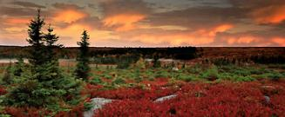


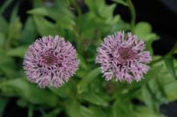

Non-Native Invasive Species: Why Should You Care?
Rosalie Santerre
Potomac Highlands CWPMA
Notes:
Good afternoon and welcome to Discover Invasive Species Day! My name is Rosey Santerre, I’m the acting of the Potomac Highlands Cooperative Weed and Pest Management Area. I’d like to talk to you about Invasive Plant Species, how they effect you and why you should care.

Slide 2
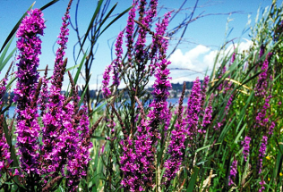
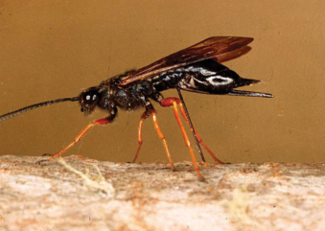
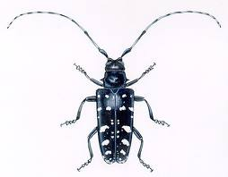
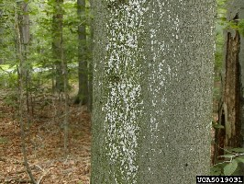
What are Invasive Species?
Notes:
An invasive species can be a plant animal or microbe. They are not native to a particular ecosystem and cause damage to the ecosystem that they are introduced to. People often confuse the terms exotic and invasive. All exotic species are not necessarily invasive. To be invasive in a new ecosystem a specie must…

Slide 3
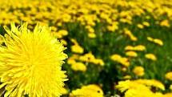
Are all non native species invasive?

Slide 4
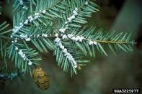
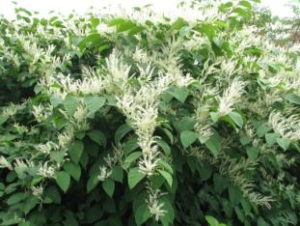
What qualities make species invasive?
Exotic?
Rapid Growth Rate
High Seed Production
No Predators
Early Germination
Cause Environmental and/or Economic Damage!
Notes:
When most people think of invasive plants, they think of foreign or exotic plants. Just because a plant is “alien” to a geographic growth range, does not make it invasive. Japanese knotweed is not threatening just because it’s from Japan. In fact, there are many exotic species that exist in harmony with our natural environments, such as pear and apple trees, daffodils… Invasive species are plants that grow quickly and aggressively, producing staggering amounts of seeds, they often sprout in disturbed areas before any other plant has a chance to move in. This makes them more robust and resistant to methods of control. As a foreign plant, they also may not have any native predators or diseases to keep their growth in check. These characteristics are what makes a plant “invasive” and threatening to our native ecosystems. *first to leaf out, multiflora, autumn olive, bush honeysuckle.

Slide 5
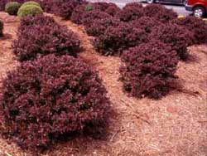

How did they get here?
Intentionally
Accidentally
Notes:
And how exactly have they gotten here? Well, many non-native species are introduced with the best of intentions. Some were brought to the US for purposes of erosion control, or because they were attractive to gardeners and horticulturalists, some were used as forage crops or had medicinal uses, some were thought to be used as wildlife foods, and others simply got here by accident being carried across the oceans on ships. Such was the case with japanese stiltgrass was originally used as packing material and accidentally made its way onto American shores from the shipping yards.

Slide 6
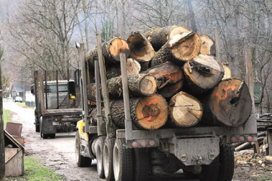
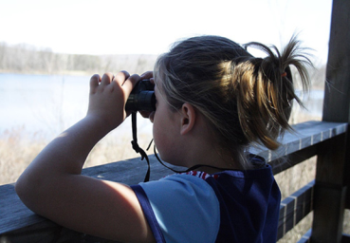
What do we have to lose?
West Virginia
Wood products industry = $4 billion annually and 30,000 jobs.
Recreational pursuits= $803 million annually.

Slide 7
What do we have to lose?
The forests contribute to the overall quality of life by
reducing energy costs
lowering pollution
protecting watersheds from erosion and sedimentation
providing for long -term carbon sequestration
improving air quality

Slide 8
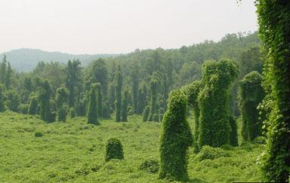
Notes:
I think this picture illustrates the awful threat that invasive species can pose on native habitats. Kudzu is one of the most infamous invasive plant species that is currently wreaking havoc throughout many southern states. Here, it’s made it’s way up to a forest in Illinois. Without diligent efforts toward treatment and prevention, our beautiful west Virginian forests may soon wrestle with this invader as well. The effects of invasive species resonates throughout an ecosystem causing major problems for many interest groups and activities in our forests. Can you imagine trying to hunt or fish in an environment like this? Or what if this green, leafy scourge was threatening to grow on YOUR property?

Slide 9
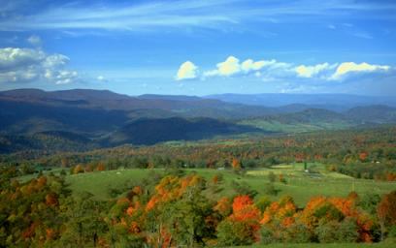
WHY SHOULD WE CARE?
If left unchecked, invasive species will limit many uses on lands now and for future generations
The wetlands, prairies, forests, lakes, and rivers as we know and love them may be less diverse and vibrant for our children
Notes:
If left unchecked, invasive plants will limit many uses on lands now and for future generations. The extent and locations of infestations will spread quickly to your favorite fishing, hunting, and hiking areas, and even to your own backyard if nothing is done to manage them. The natural areas of West Virginia as we know and love them will become less diverse and vibrant for our children if we don’t try to control invasives today.

Slide 10
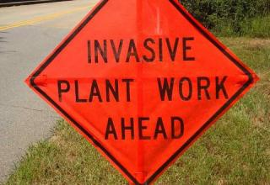
An ounce of prevention is worth a pound of cure!
Save Time
Save Energy
Save Money
Protect Native Landscapes!
Notes:
When it comes to non-native invasive species, an ounce of prevention is worth a pound of cure! The best way to preserve West Virginia’s native plants is to remove unwanted invasives as soon as they get here. Once the invasives take hold in large infestations, they become extremely difficult to eradicate. That’s why proper identification and reporting of these invasives is so key!

Slide 11

What YOU Can Do….
Don’t plant invasive plants.
Don’t move firewood.
Clean equipment, clothing and gear when moving between different outdoor activities.
Manage invasive species on your land, look to your extension agent for more information
Contact the Potomac Highlands CWPMA to report infestations and learn more about how to manage them

Slide 12
Lets Learn to Identify Some!
5 plants
3 insects
2 diseases

Slide 13
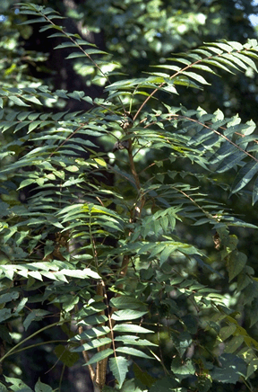
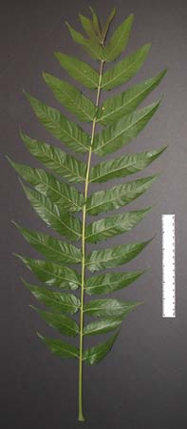
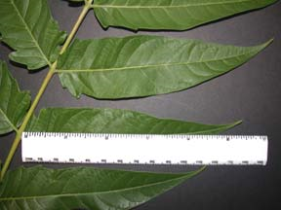
Tree of Heaven (Ailanthus altissima)
Notes:
Ailanthus altissima – Tree of Heaven
Fast growing tree and prolific seed producer.
Mature trees can reach 80’ in height. Dieocious.
Smooth stems and pale gray bark.
Compound leaves 1-4’ in length; alternate with 10-41 smaller leaflets.
Each leaflet hast 1 or more glandular teeth at the base but is otherwise smooth.
Look-alikes include sumac, ash, hickory, walnut and butternut but have toothed margins.

Slide 14
Ailanthus altissima – Tree of Heaven
Ecological Threat:
Tree-of-heaven is a fast-growing tree and a prolific seeder, that can take over sites, replacing native plants and forming dense thickets.
produces chemicals that prevent the establishment of other plant species nearby.
root system may be extensive and has been known to cause damage to sewers and foundations.

Slide 15
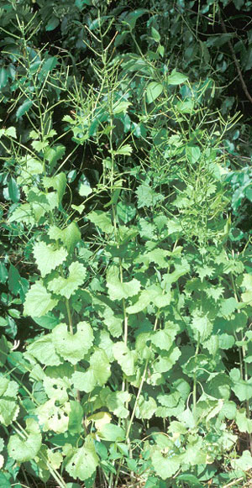
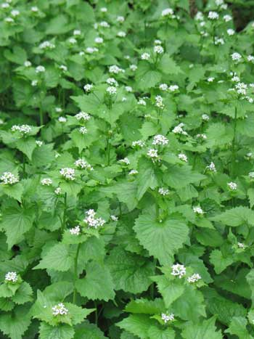
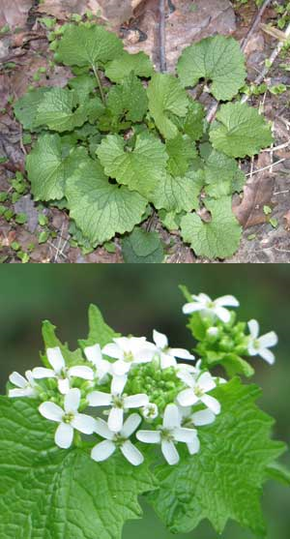
Garlic Mustard (Alliaria petiolata)
Notes:
Alliaria petiolata – Garlic Mustard
cool season biennial herb with stalked, triangular to heartshaped,coarsely toothed leaves that give off an odor of garlic when crushed.
First-year plants appear as a rosette of green leaves close to the ground.
Flowering plants of garlic mustard reach from 2 to
3½ feet in height and produce clusters of small white flowers, with four petals in the shape of a cross.
Look -alikes include violets, early bloodroot, toothworts, saxifrage and other spring wildflowers with white flowers.

Slide 16
Alliaria petiolata – Garlic Mustard
Ecological Threat
garlic mustard outcompetes native plants by aggressively monopolizing light, moisture, nutrients, soil and space.
Wildlife species that depend on these early plants for their foliage, pollen, nectar, fruits, seeds and roots, are deprived of these essential food sources when garlic mustard replaces them.
Garlic mustard also poses a threat to one of our rare native insects, the West Virginia white butterfly (Pieris virginiensis). Several species of spring wildflowers known as "toothworts" (Dentaria), also in the mustard family, are the primary food source for the caterpillar stage of this butterfly. Invasions of garlic mustard are causing local extirpations of the toothworts, and chemicals in garlic mustard appear to be toxic to the eggs of the butterfly, as evidenced by their failure to hatch when laid on garlic mustard plants.

Slide 17
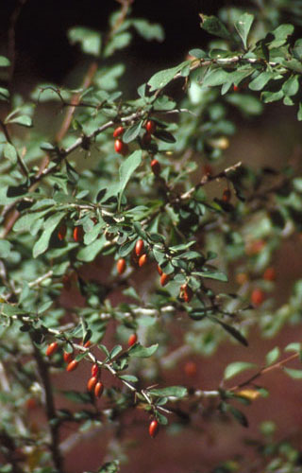
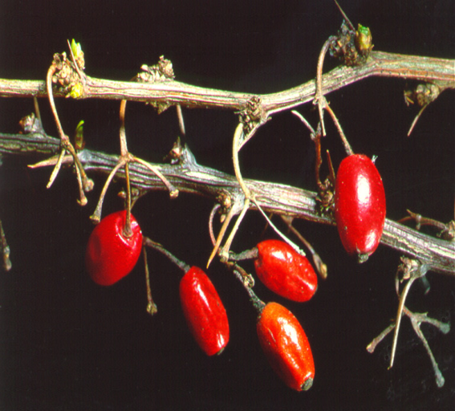
Japanese barberry (Berberis thunbergii)
Notes:
Berberis thunbergii – Japanese barberry
Dense, deciduous, spiny shrub that grows 2 to 8 ft.
The branches are brown, deeply grooved, and bear a single very sharp spine at each node.
Leaves are small (½ to 1 ½ in. long), oval to spatula-shaped, green, bluish-green, or dark reddish purple.
Flowering occurs from mid-April to May. Pale yellow flowers about ¼ in across hang in umbrella-shaped clusters of 2-4 flowers.
The fruits are bright red berries about 1/3 in (1 cm) long that are borne on narrow stalks.
Japanese barberry may be confused with American barberry (Berberis canadensis), the only native species of barberry in North America, and common or European barberry (Berberis vulgaris) which is an introduced, sometimes invasive plant.

Slide 18
Berberis thunbergii – Japanese barberry
Ecological Threat:
Japanese barberry forms dense stands in natural habitats including canopy forests, open woodlands, wetlands, pastures, and meadows and alters soil pH, nitrogen levels, and biological activity in the soil.
Once established, barberry displaces native plants and reduces wildlife habitat and forage.
White-tailed deer apparently avoid browsing barberry, preferring to feed on native plants, giving barberry a competitive advantage.
In New Jersey, Japanese barberry has been found to raise soil pH (i.e., make it more basic) and reduce the depth of the litter layer in forests.

Slide 19
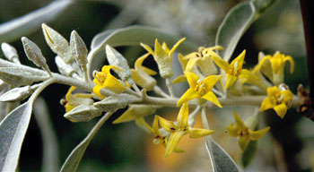
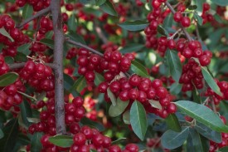
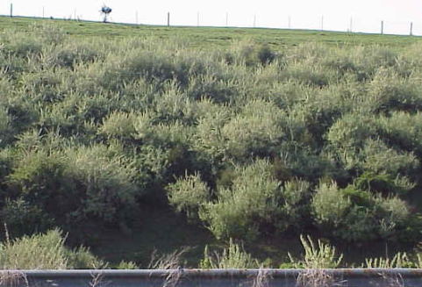
Autumn olive (Elaegnus umbellata var. parvifolia)
Notes:
Elaegnus umbellata var. parvifolia – Autumn olive
Small, usually thorny shrub or small tree that can grow to 30 feet in height.
Its stems, buds, and leaves have a dense covering of silvery to rusty scales.
Leaves are egg or lance-shaped, smooth margined, and alternate along the stem.
At three years of age, plants begin to flower and fruit. Highly aromatic, creamy yellow flowers appear in June and July and are later replaced by clusters of abundant silvery fruits.

Slide 20
Elaegnus umbellata var. parvifolia – Autumn olive
Ecological Threat:
Olive can outcompete native vegetation, interfere with natural plant succession and nutrient cycling, and tax water reserves.
Because olive is capable of fixing nitrogen in its roots, it can grow on bare, mineral substrates and dominate riparian vegetation where overstory cottonwoods have died.
Although olive provides a plentiful source of edible fruits for birds, ecologists have found that bird species richness is actually higher in riparian areas dominated by native vegetation.

Slide 21
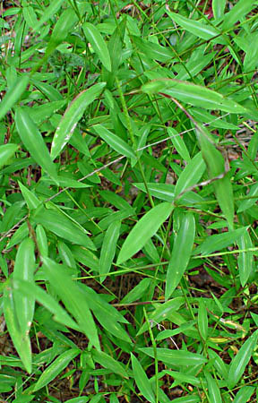
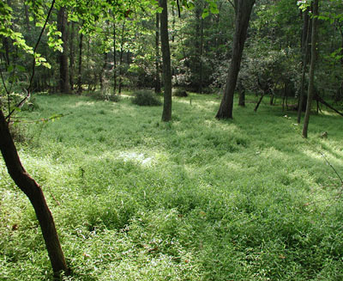
Japanese Stiltgrass (Microstegium vimineum)
Notes:
Microstegium vimineum – Japanese Stiltgrass
Annual grass with a sprawling habit. Germinates in spring reaching heights of 2 to 3½ ft.
The leaves are pale green, lance-shaped, 1 to 3 in. long, and have a distinctive shiny midrib
Slender stalks of tiny flowers are produced in late summer (August through September-early October) and dry fruits called achenes are produced soon afterwards.
Stiltgrass occurs in a wide variety of habitats including moist ground of open woods, floodplain forests, wetlands, uplands, fields, thickets, paths, clearings, roadsides, ditches, utility corridors, and gardens. It readily invades areas subject to regular mowing, tilling, foot traffic, and other soil disturbing activities as well as natural disturbances

Slide 22
Microstegium vimineum – Japanese Stiltgrass
Ecological Threat:
Forms extensive patches, displacing native species that are not able to compete with it.
White-tail deer may facilitate its invasion by feeding on native plant species and avoiding stiltgrass.
Japanese stiltgrass may impact other plants by changing soil chemistry and shading other plants.
Further investigation is needed to study the potential impacts of stiltgrass on Northern Pearly Eye and possibly other butterflies or other insects that utilize stiltgrass as an alternative host plant.

Slide 23
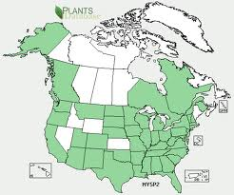
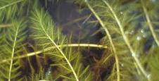
Eurasian Water Milfoil (Myriophyllum spicatum)

Slide 24
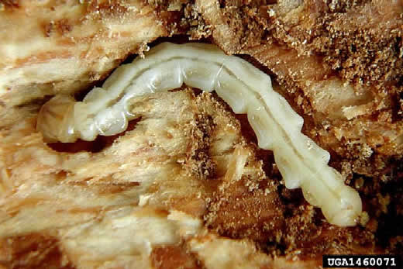
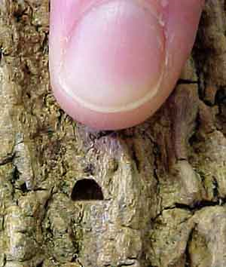
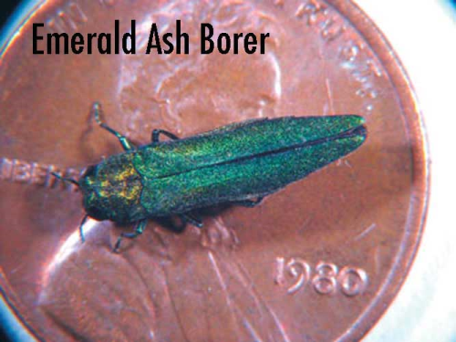
Emerald ash borer (Agrilus planipennis)
Notes:
Emerald ash borer (EAB), Agrilus planipennis
an exotic beetle that was discovered in southeastern Michigan near Detroit in the summer of 2002.
The adult beetles nibble on ash foliage but cause little damage.
The larvae (the immature stage) feed on the inner bark of ash trees, disrupting the tree's ability to transport water and nutrients.
Emerald ash borer probably arrived in the United States on solid wood packing material carried in cargo ships or airplanes originating in its native Asia.

Slide 25
Emerald ash borer (EAB), Agrilus planipennis
Ecological Threat
All ash species in WV are attacked, including white, green black and blue ash. Mountain ash (Sorbus spp.), not a true ash, is unaffected.
Emerald ash borer is a slow-moving insect, dispersing just one-half to two miles annually on its own. However, this rate of dispersal can be greatly accelerated by humans transporting ash firewood, nursery stock and other wood products long distances.

Slide 26
Insects
Hemlock Wooly Adelgid - (Adelges tsugae)
Small, aphidlike insect that threatens the health and sustainability of eastern hemlock (Tsuga canadensis) and Carolina hemlock (Tsuga caroliniana).
First reported in the Eastern United States in 1951 near Richmond, Virginia.
Hemlock decline and mortality typically occur within 4 to 10 years.
The hemlock woolly adelgid is tiny, less than 1/16-inch (1.5-mm) long, and varies from dark reddish-brown to purplish-black in color.
it produces a covering of wool-like wax fi laments to protect itself and its eggs from natural enemies and prevent them from drying out.

Slide 27
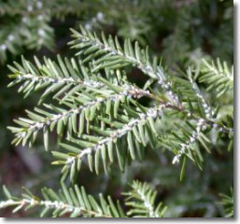
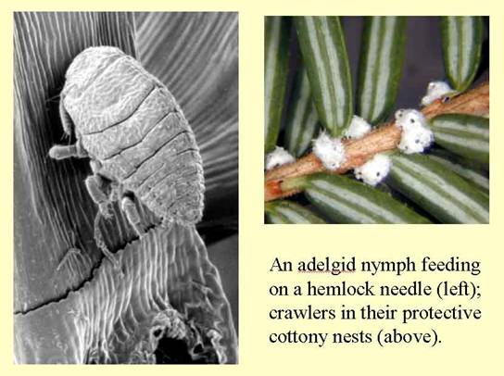
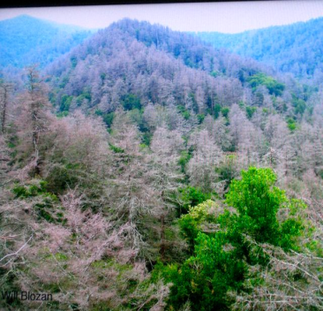
Hemlock Wooly Adelgid (Adelges tsugae)

Slide 28
Hemlock Wooly Adelgid - (Adelges tsugae)
Ecological Threat
Ecosystem services derived from hemlock forests include the protection of riparian habitat supporting coldwater species such as trout, the aesthetic value of old growth hemlock stands,, and the aesthetic value.
Creates tree gaps that are potentially invaded by plant NNIS.
Loss of habitat for a number of migratory birds including Black-throtated green warbler.
Loss of tourism revenue?

Slide 29
Insects
Asian Long horned beetle – (Anoplophora glabripennis)
A large black insect, with white spots dashed irregularly on its wing covers. Adults are typically 1–1.5 inches (2.5–3.8 cm) long.
Trees favored by the Asian Longhorned Beetle are predominantly maples, but infestations have also been discovered in horsechestnuts, poplars, willows, elms, mulberries and black locusts.
Infestations have been discovered in Brooklyn and Amityville, New York, and in Chicago, Illinois.
In all cases of infestation, the affected trees are cut down and the wood destroyed.

Slide 30
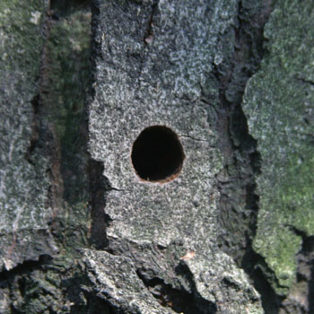
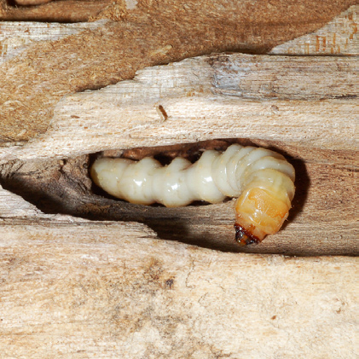
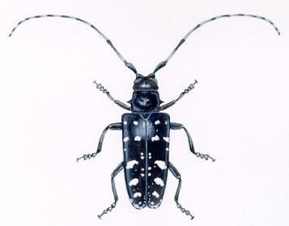
Asian Long horned beetle – (Anoplophora glabripennis)

Slide 31
Asian long horned beetle – (Anoplophora glabripennis)
Trees at Risk:
Ash
Birches
Elm
European mountain ash
Hackberry
Horsechestnut
Maple
Mimosa
Poplars
Willow

Slide 32
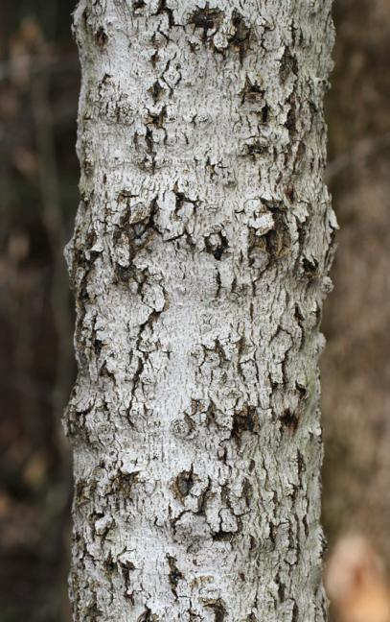
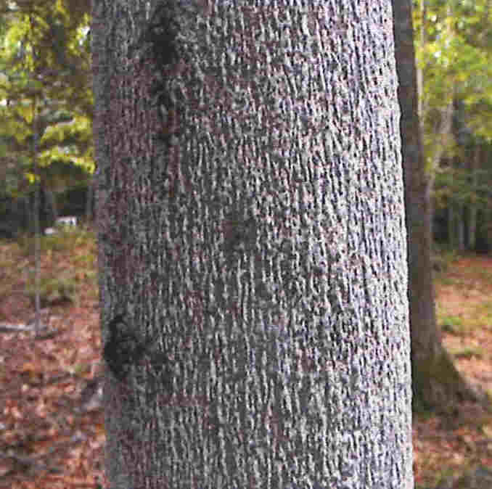
Beech Bark Disease Cryptococcus fasisuga, Nectria spp.

Slide 33
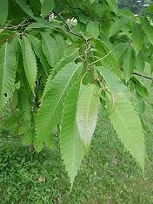
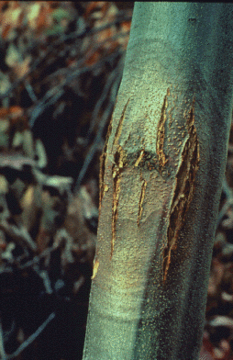
American Chestnut Blight- Endothia parasitica

Slide 34
What is the Potomac Highlands Cooperative Weed and Pest Management Area?

Slide 35
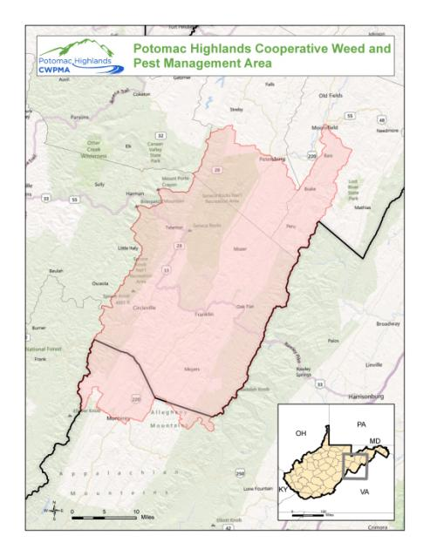
Notes:
This is what motivated the creation of the Potomac Highlands Cooperative Weed and Pest Management Area. We are a partnership between federal, state, and local agencies as well as non-profits and private landowners. We’re all working together to pool resources and information to control invasive species in our target area, the Potomac highlands. We’ve targeted this are, including Pendleton, Grant, and Hardy counties as well as a portion of Augusta county in Virginia, because it is home to the important headwaters region of the Potomac River. From this point, invasive species can spread from the beginning of the Potomac River down to its many tributaries and throughout the watershed. There are also many native, sensitive plant and wildlife species located in this area, making it a very special, authentic West Virginian natural area.

Slide 36










Notes:
Here is a listing of some of our current partners. We are continually to looking for ways to expand and enhance these partnerships in order to make our work more effective. As partners, we seek to assist each other in meeting individual organization goals as well as goals of the CWPMA.

